Slide 1
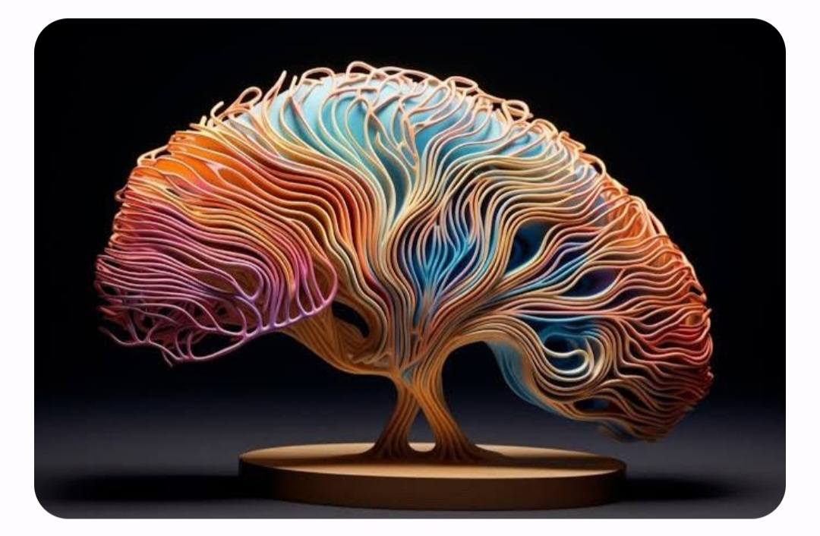
Brain Tumor Classification
Alin Finkelshtein and Felix Doctorman

Slide 2

Brain tumors
Optic nerve glioma
Medulloblastoma
Neurofibroma
Mixed glioma
Hemangioblastoma
Ependymoma
Oligodendroglioma
Glioblastoma multiforme
Craniopharyngioma
Gliomas
Pituitary adenoma
Astrocytoma
Choroid Plexus Tumors
Brainstem glioma
Schwannoma
Meningioma
Chordoma
Primary central nervous system lymphoma
Vestibular schwannoma
Pilocytic astrocytoma
Germ cell tumor
Primitive neuroectodermal tumor
diffuse Astrocytomas
Anaplastic astrocytoma

Slide 3
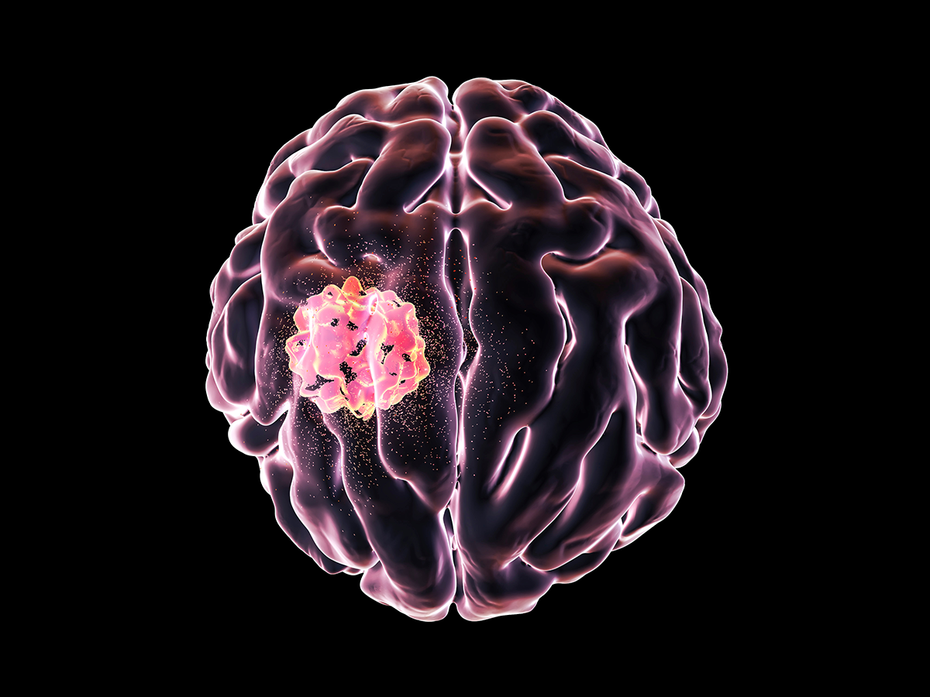
We will concentrate on 3
Glioma
Meningioma
Pituitary
Glioma starts in the glial cells
About 33 percent of all brain tumors
Gliomas can affect all ages, but they are most often seen in adults.
There are different gliomas, with different growth potential and aggressiveness
Symptoms of glioma appear slowly and may be subtle at first. Some gliomas do not cause any symptoms
Meningioma starts in the meninges, which are membranes surrounding and protecting the brain.
30 percent of all brain tumors.
They grow slowly and may exist for years before being detected.
Pituitary tumor starts in the pituitary gland.
About 25% of people may have small pituitary tumors
It is located behind the back of the nose.
It makes hormones that affect many functions in your body.
Most pituitary tumors are benign.
They don’t spread to other parts of your body
But they can cause the pituitary to make too few or too many hormones, causing problems in the body.
Most pituitary tumors don’t cause symptoms. As a result, they are not diagnosed.

Slide 4
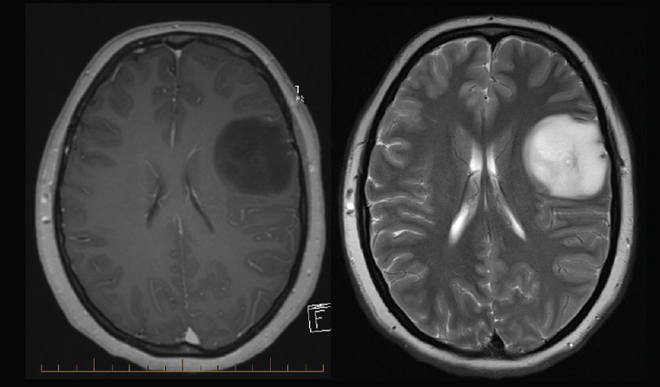
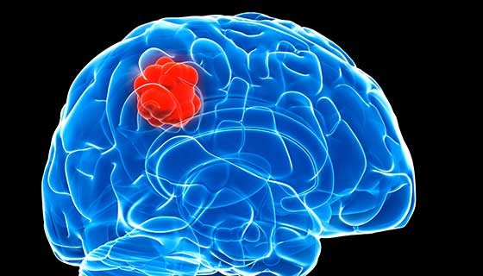
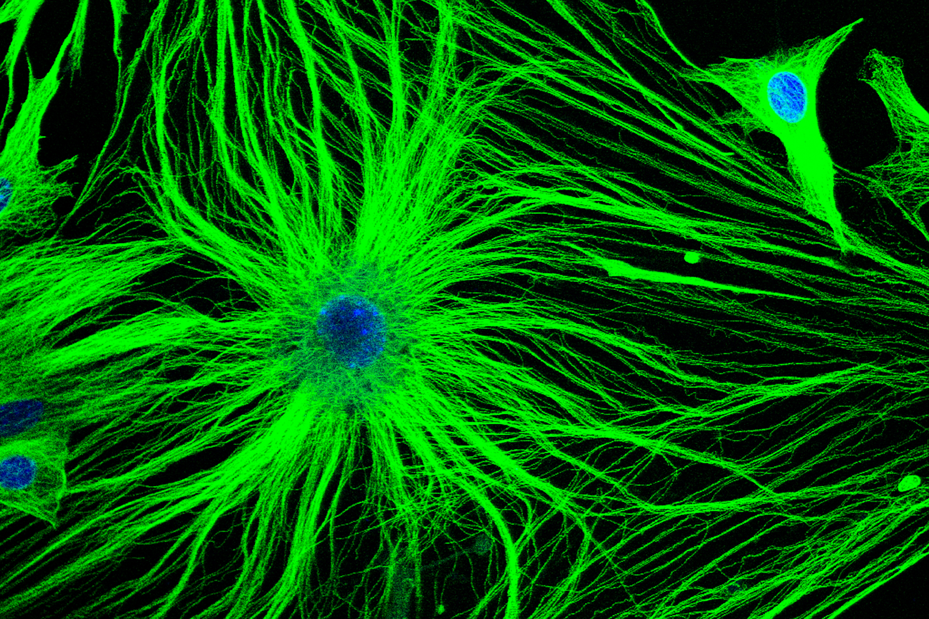
Glioma
Is a common type of tumor originating in the brain.
About 33 percent of all brain tumors are gliomas,
Glioma originate in the glial cells that surround and support neurons in the brain, including astrocytes, oligodendrocytes and ependymal cells.
There are different types of gliomas
Astrocytomas
Brain stem gliomas,
Ependymomas
Mixed gliomas
Oligodendrogliomas
Optic pathway gliomas

Slide 5
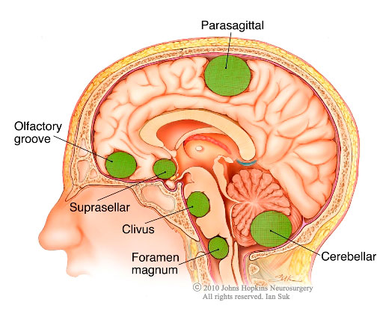
Meningioma
The beginnings of this growth typically form in the meninges, which are membranes surrounding and protecting the brain.

Slide 6
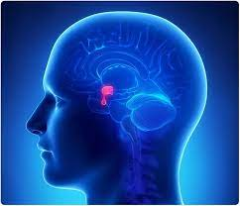
Pituitary tumor
The pituitary gland is a small, pea-sized organ in the brain.
It is located behind the back of the nose.
It makes hormones that affect many other glands and many functions in your body.
Most pituitary tumors are not cancerous (benign).
They don’t spread to other parts of your body.
But they can cause the pituitary to make too few or too many hormones, causing problems in the body.
Many pituitary tumors will also press against the nearby optic nerves. This can cause vision problems.

Slide 7

Proportion of train and test datasets

Slide 8

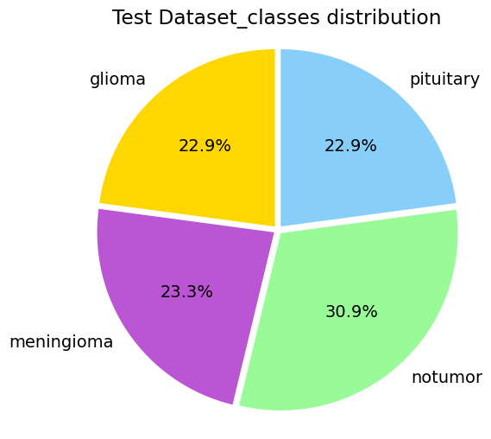
The classes are balanced

Slide 9
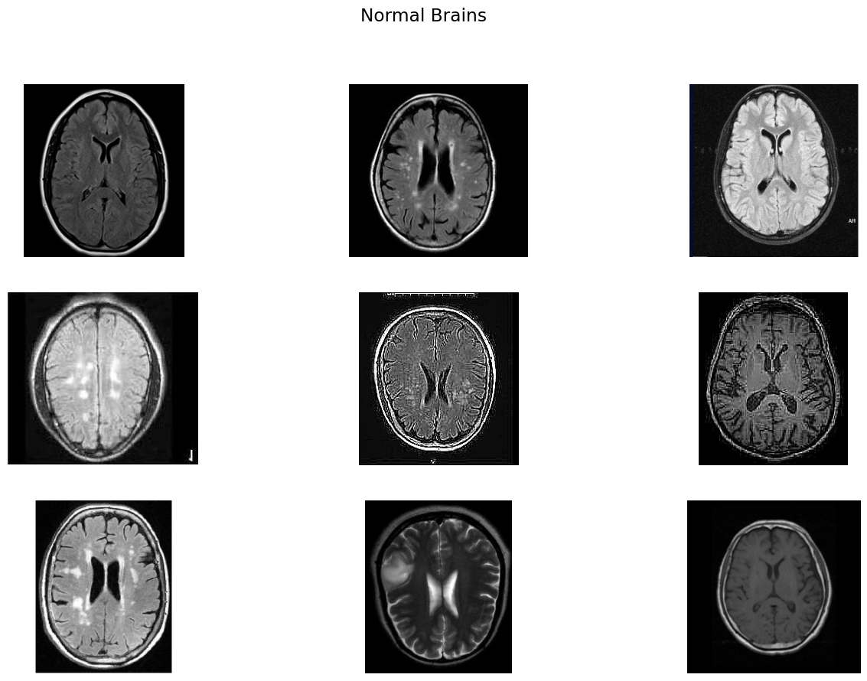

Slide 10
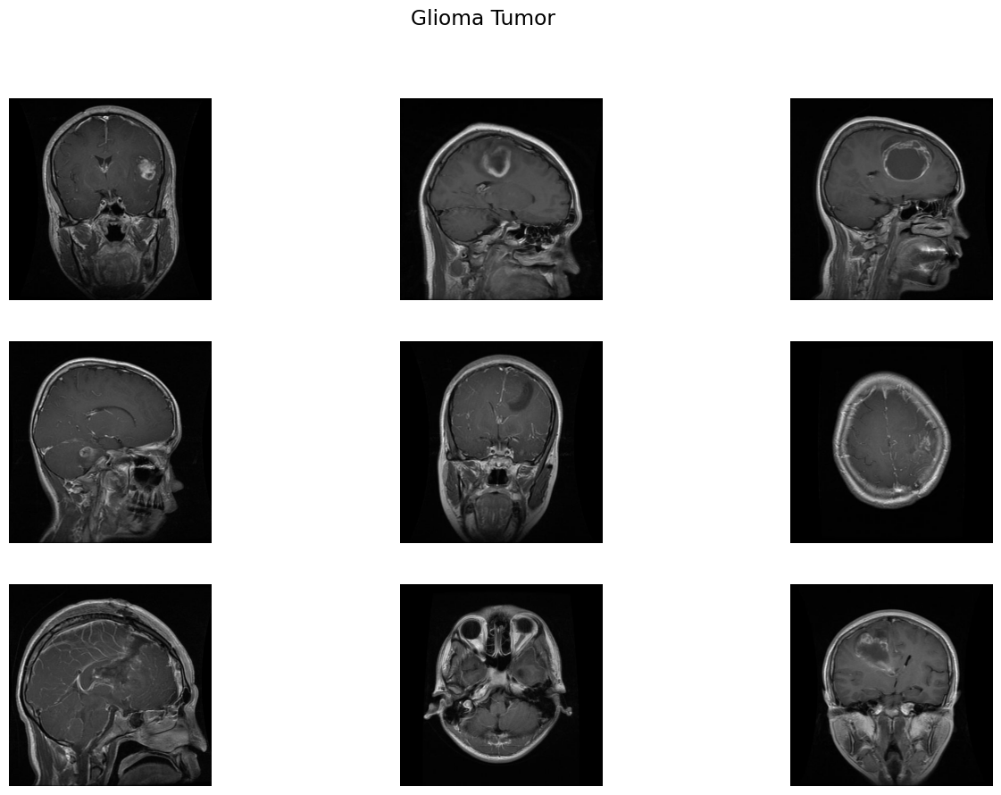

Slide 11
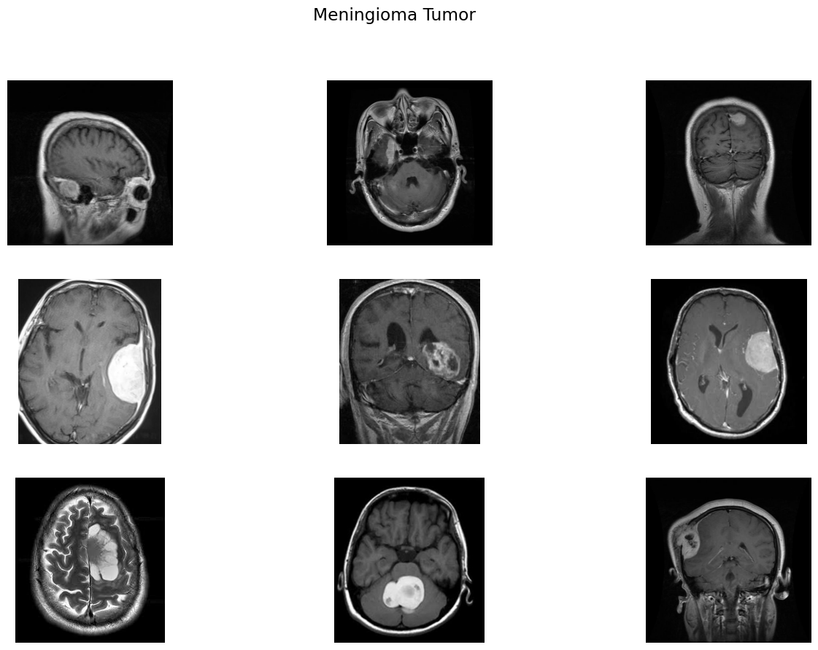

Slide 12
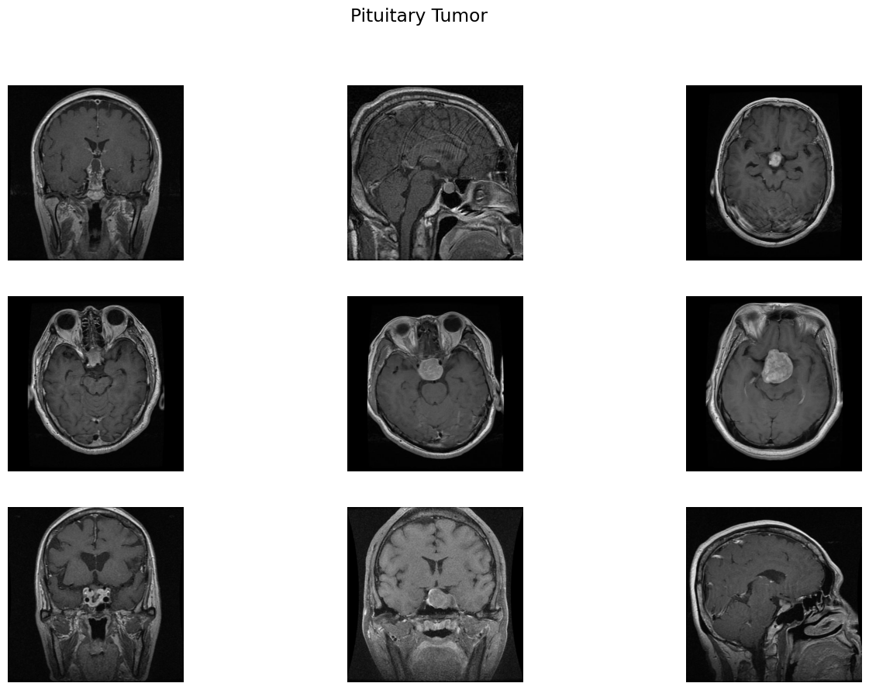

Slide 13
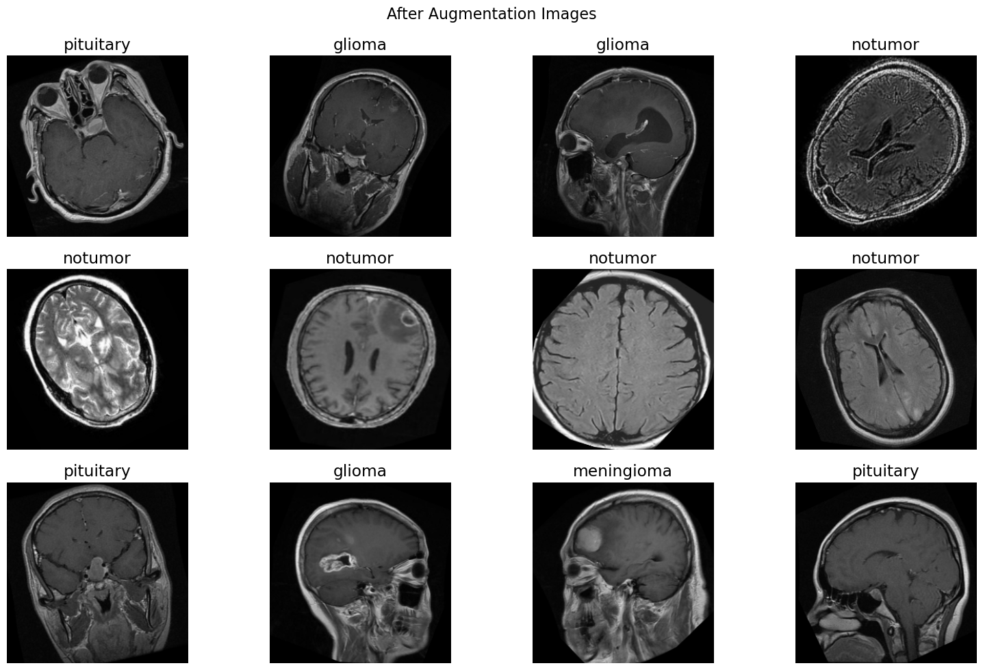

Slide 15


